Slide 1
Digital Identity
Tata Consultancy Services
Industry Advisor: Narendran Sivakumar
Faculty Advisor: Prof. Michael McCarthy
Poojitha Prasad
Nandini Nerurkar
Shunqi Wang
Waqas Aziz
Vinit Shah

Slide 2
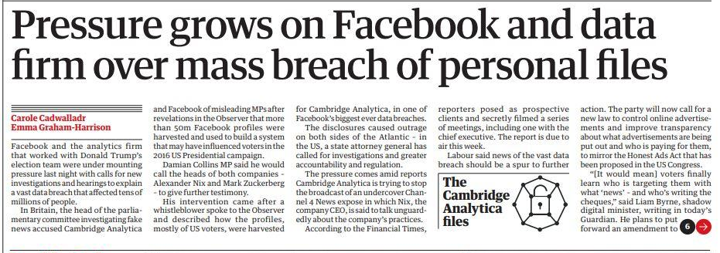
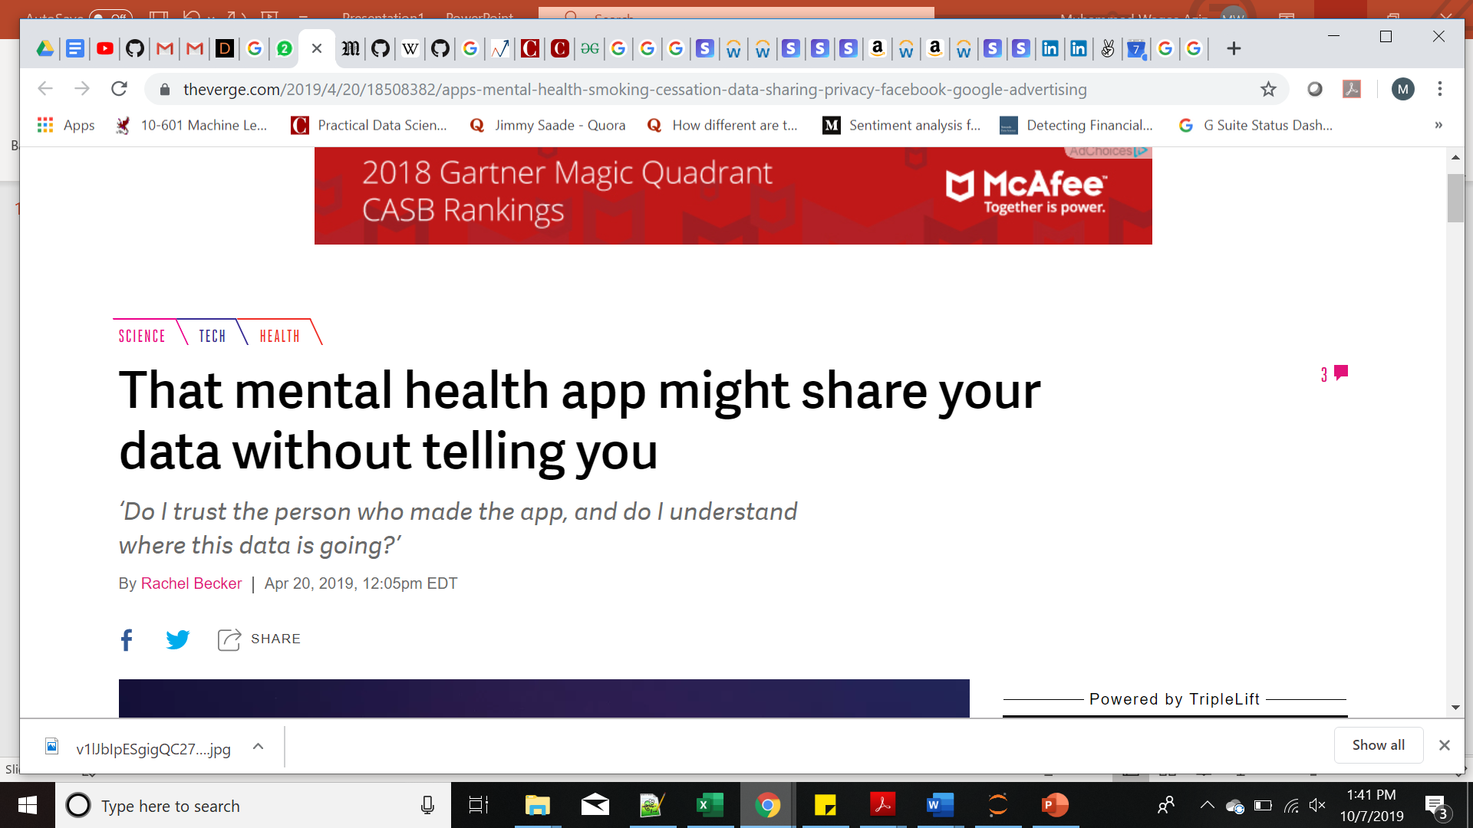
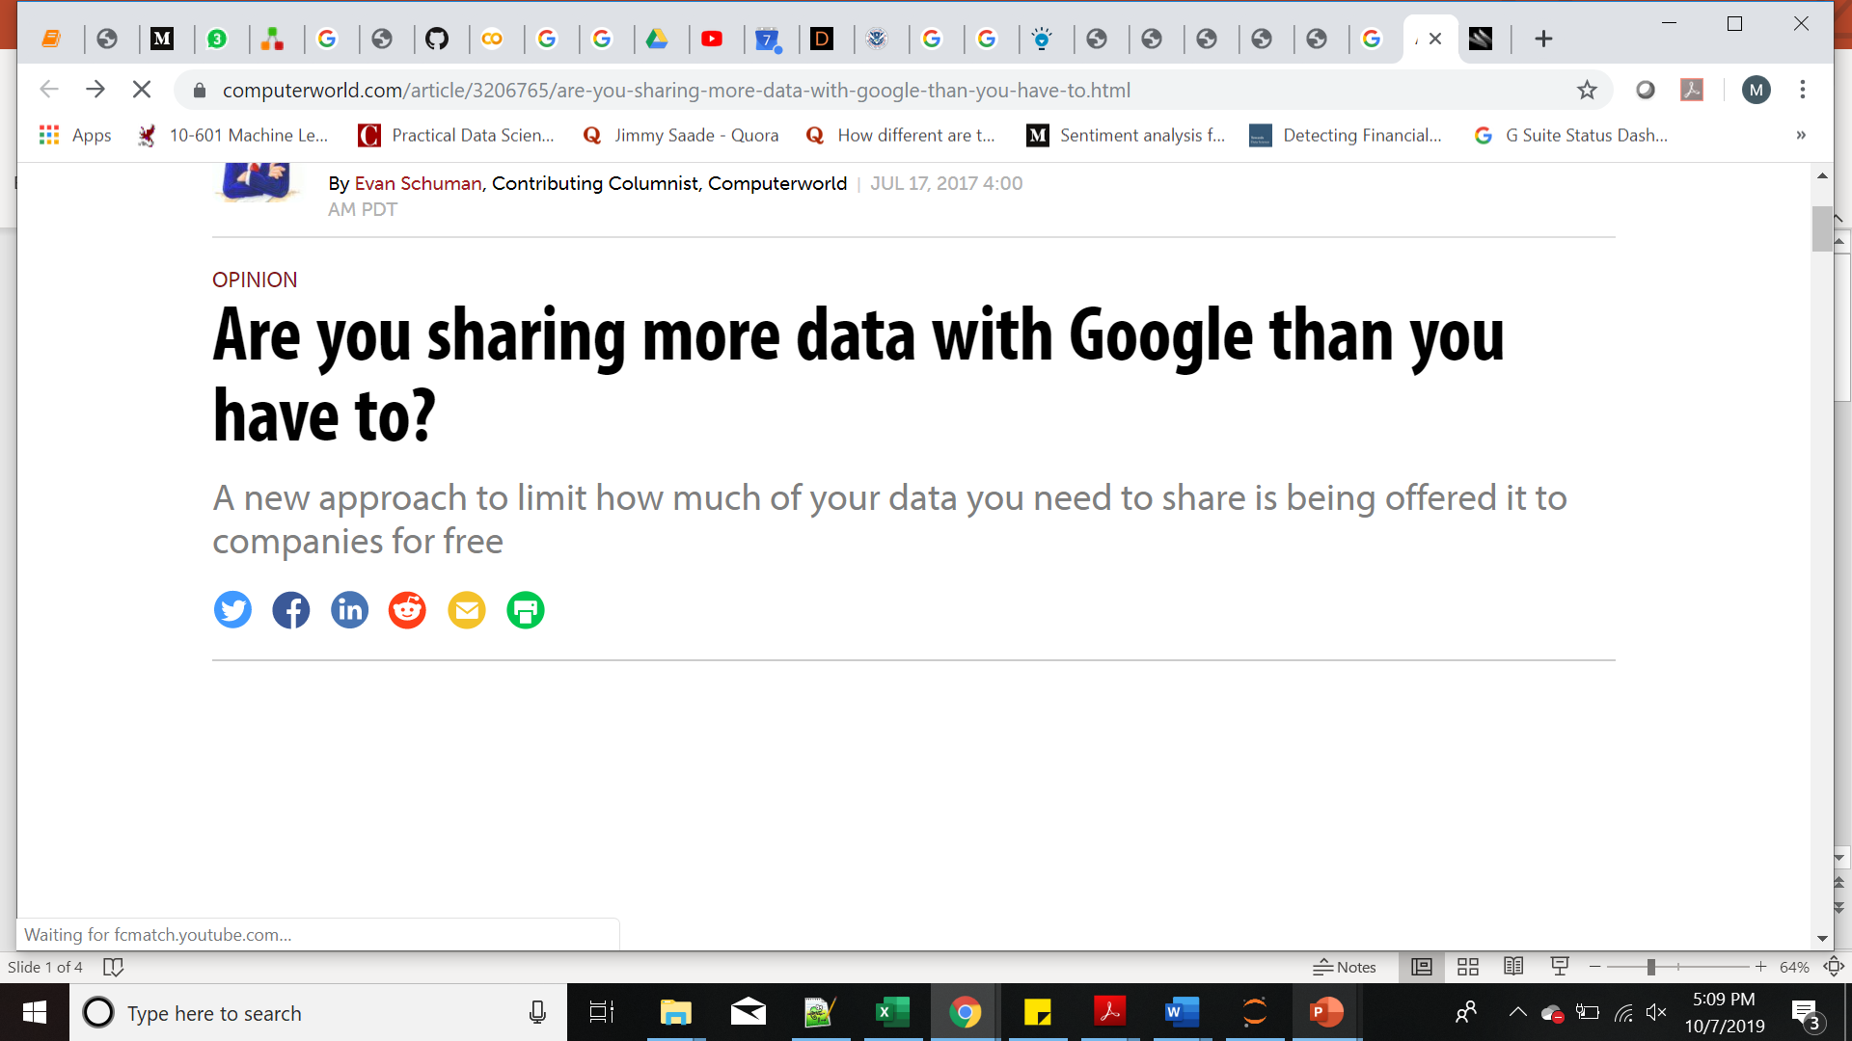
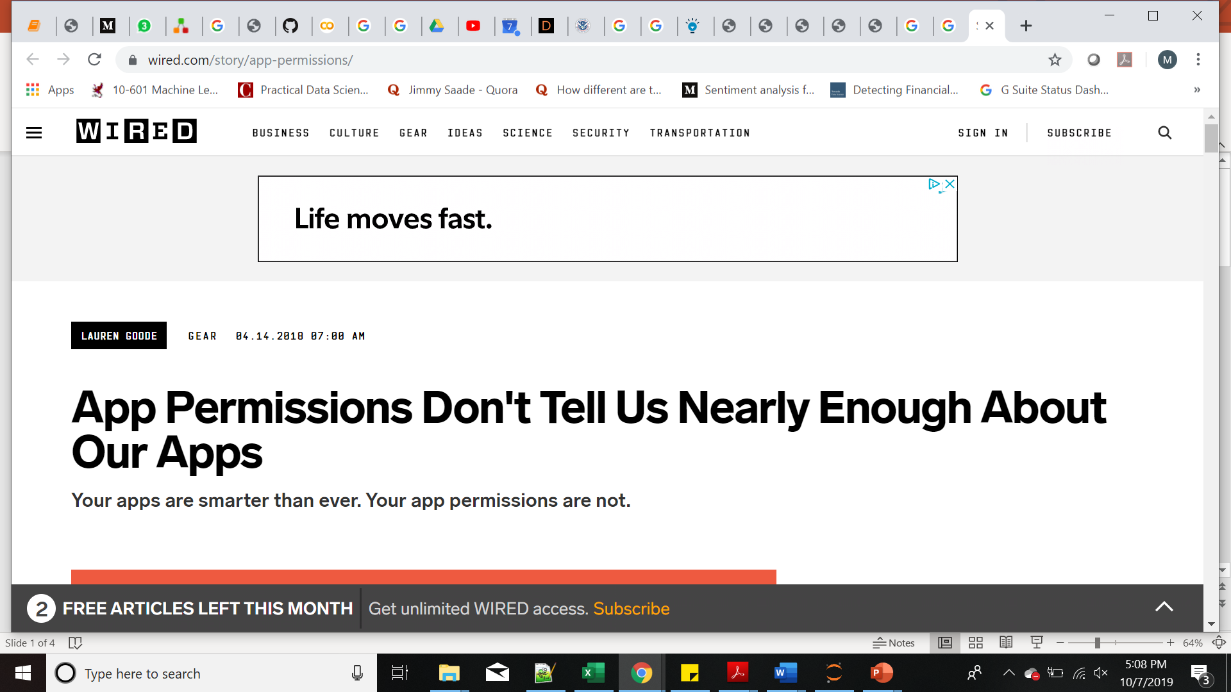
Users lack complete control on their data
References: The Guardian, The Verge, Digital Psychiatry Journal

Slide 3
Dire need to address issues surrounding data sharing and privacy
Multiple digital touchpoints
Multiple digital touchpoints
Key issues
Key issues
Data sharing with third parties
Data sharing with third parties
Control over data sharing
Control over data sharing

Slide 4
What is Digital Identity ?

Slide 5
A Digital Identity consists of the user’s personal information, health records, shopping transactions, bank details, etc.
A digital identifier or DID , is a unique 16-character alphanumeric string associated with an identity. The DID is used to retrieve the elements of the Digital Identity, via protocols that we have proposed.
Notes:
Previous definition - Unique global identifier that points to the owner’s personal data. The DID does not reveal information about the owner unless permitted.

Slide 6
Problem Statements
01
Creation and storage of Digital Identity
02
User’s control, tracking and sharing of DID
03
Carving out partial identity based on request
Registration
Authentication
Permission
Permission
Data Retrieval

Slide 7
Key Assumptions
App is secure and all databases are secure.
The producer always interacts using a trusted device and is responsible for secure storage of the private key.
Personal data has a predetermined list of universal attributes which is common for all data producers.
All network communications are over HTTPS.
All consumers are bound by a legal contract preventing the use of data for unintended purposes.

Slide 8
Creation and storage of
Digital Identifier (DID)
Notes:
We have talked about the problem statements, architecture
Create ID first time
Unique Biometrics
Creation storage

Slide 9
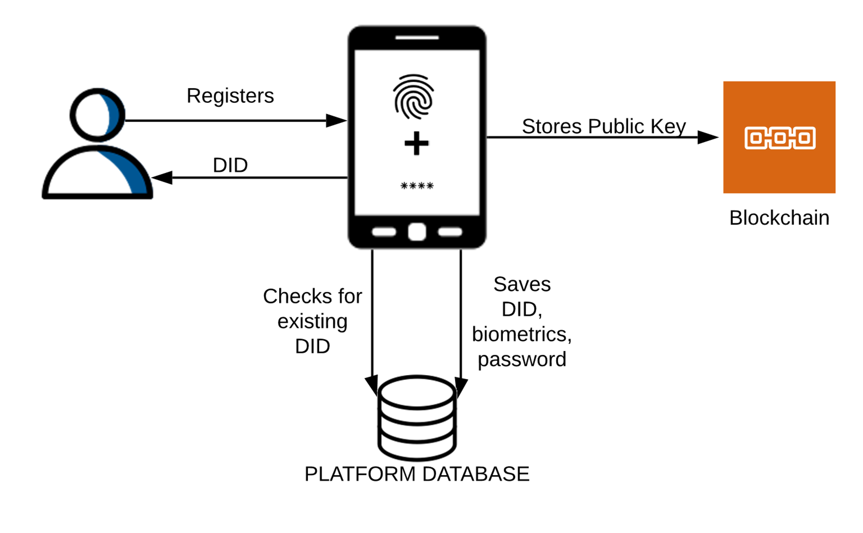
Notes:
As per our key assumption, we have a secure data store.

Slide 10
Authentication of DID
Notes:
Authentication, security, man in the middle

Slide 11
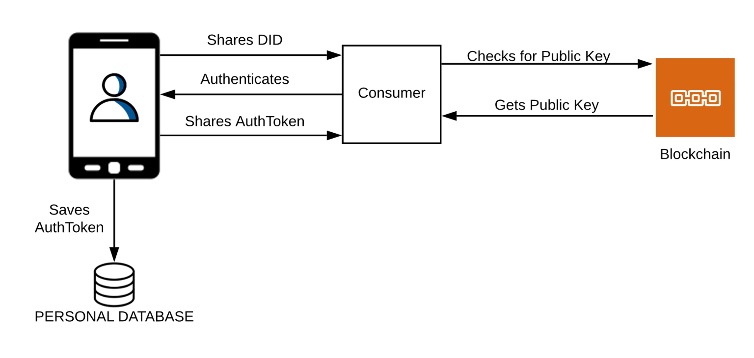
Notes:
Logging

Slide 12
Acquiring Permissions
Notes:
Control which consumers to share information with
Control which aspects of your information you share with them

Slide 13
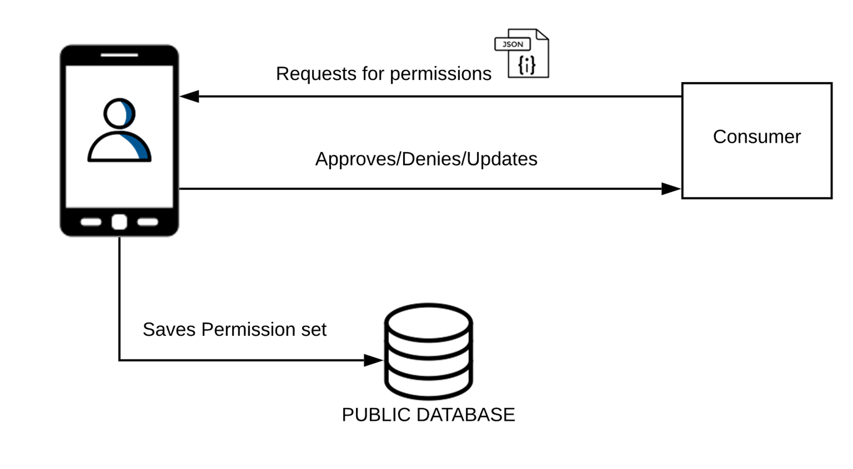

Slide 14
Data Retrieval

Slide 15
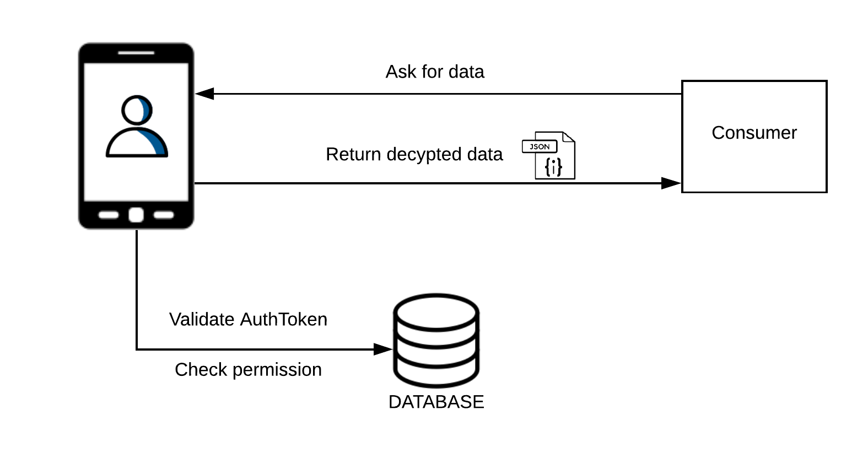
Data Retrieval
Check if the consumer is authorized
Check if they are accessing the right information
Notes:
Check if they are accessing information within the given timeframe

Slide 16
Third-party data sharing
Notes:
Analytics use? 2 sides?

Slide 17
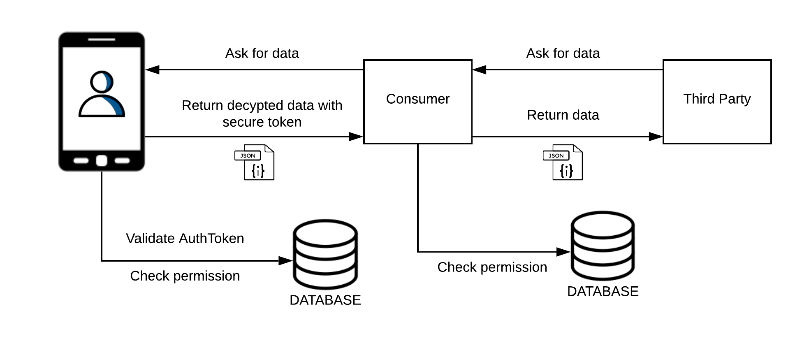
Challenges
Rules governing third-party data sharing
Truthfulness of data being shared

Slide 18
Architecture and Technologies

Slide 19
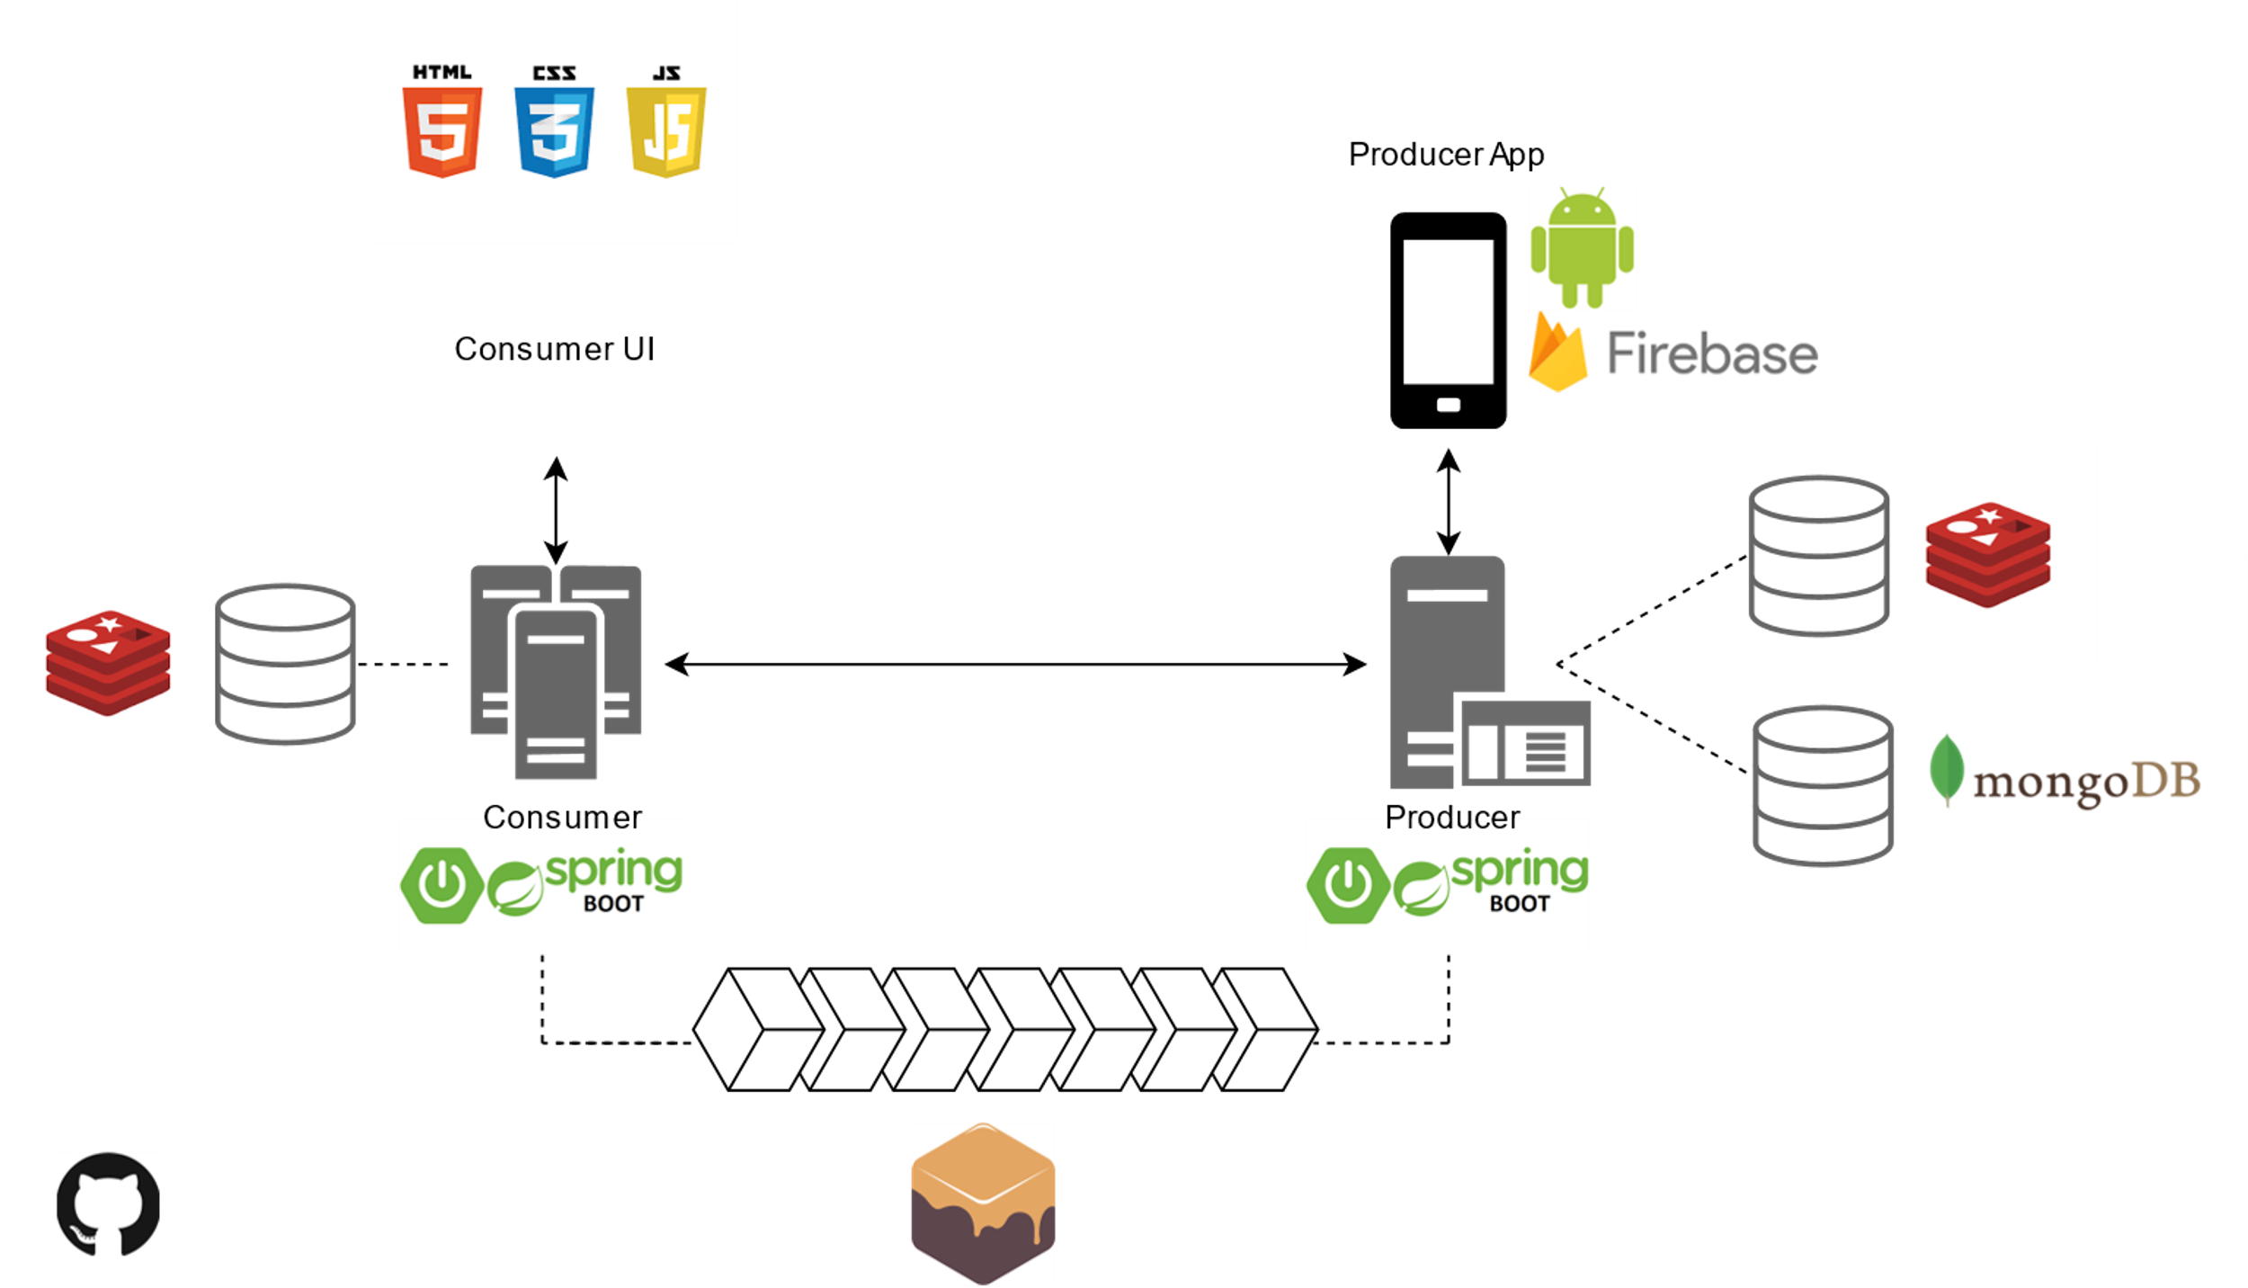


Slide 20
Demonstration

Slide 21
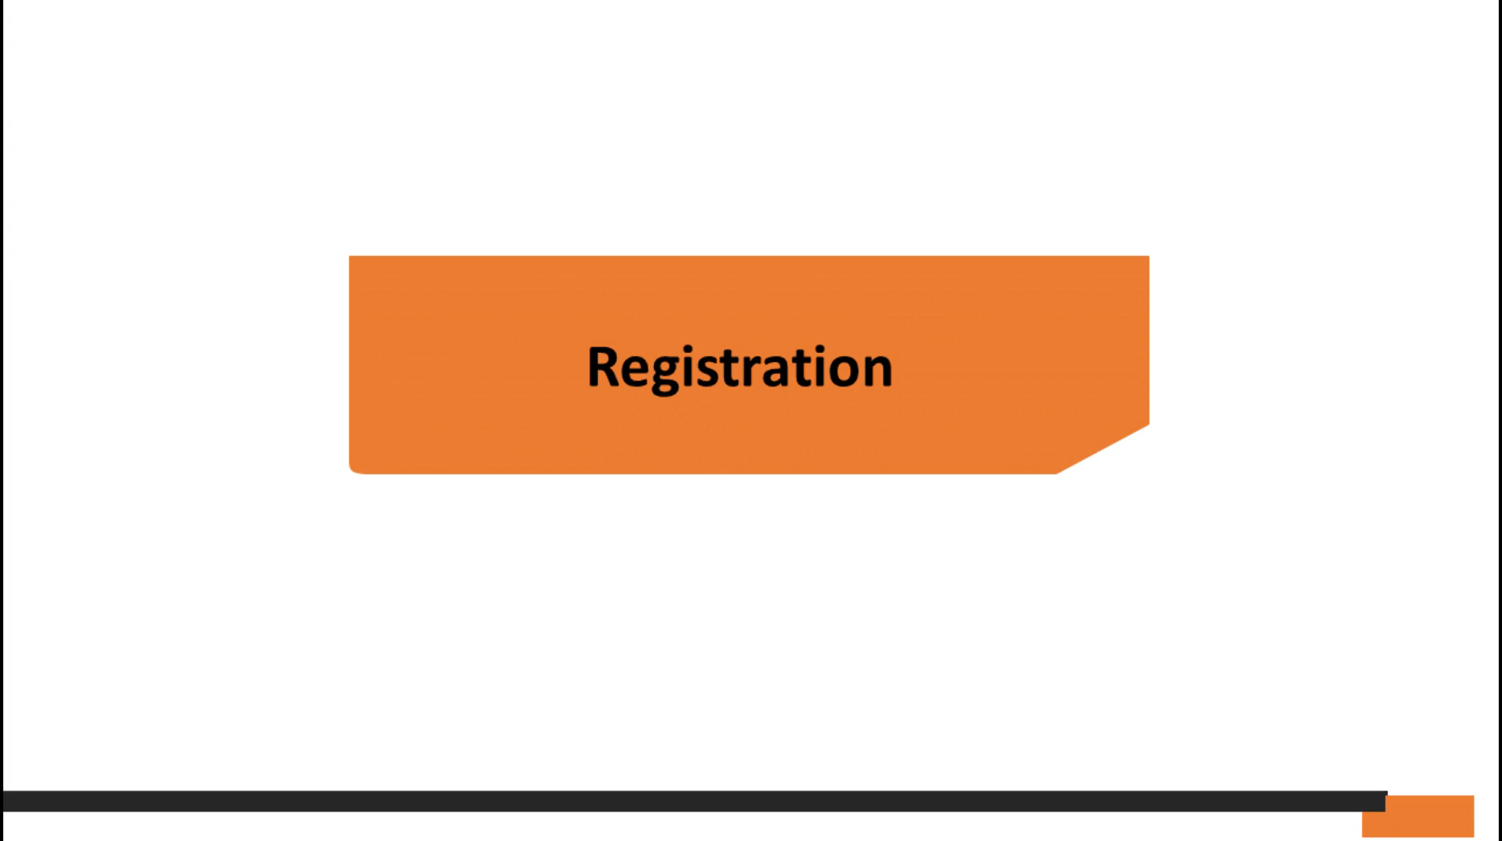

Slide 22
Use Cases

Slide 23
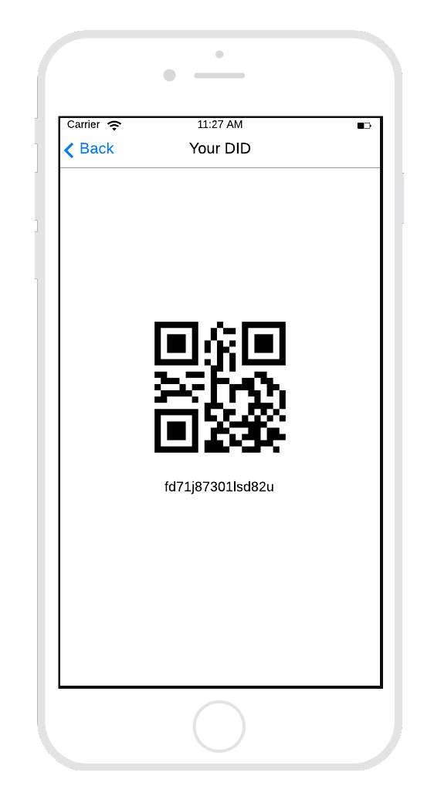




Control over Data Sharing
Notes:
Producer -> CVS -> 3rd party analytics company

Slide 24
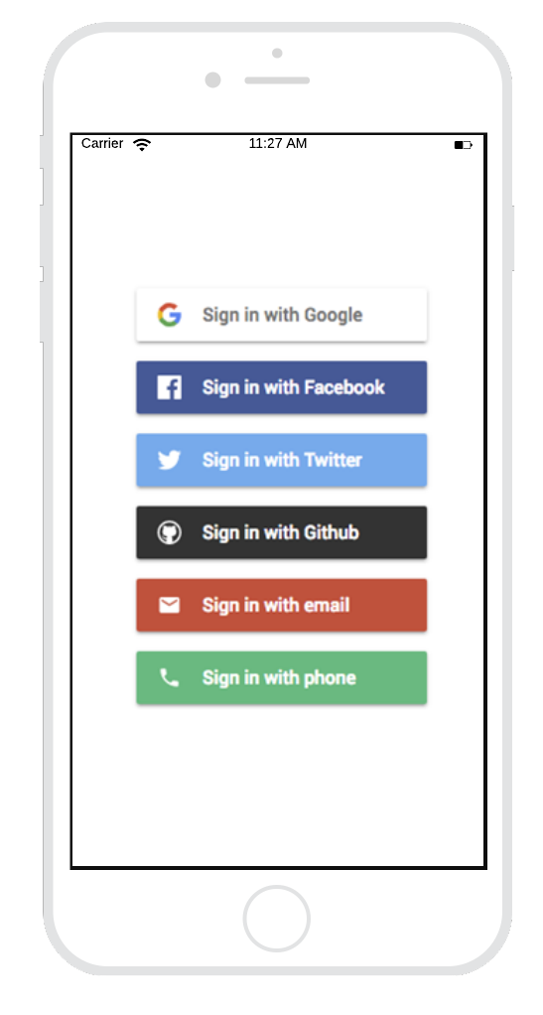
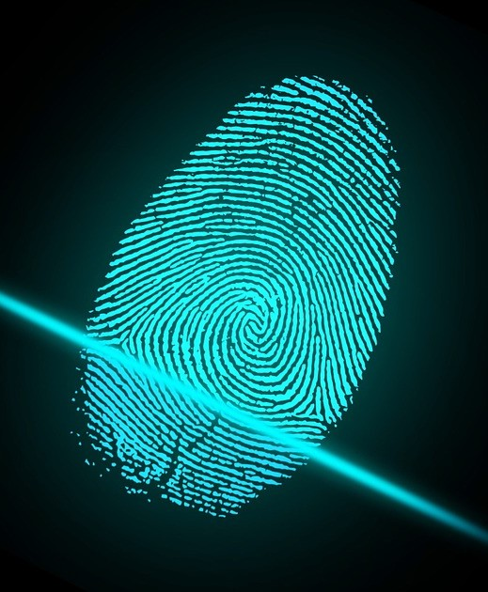
Credential Management
Notes:
Current scenario: we have to manage different accounts.
We’ll use biometrics to identify a specific user. If the user tries to register a new account, our system will detect this and reject the registration request.
User don’t have to log into different websites to view and manage their authorization and sharing options.

Slide 25
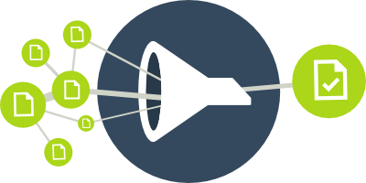
Preventing Excessive Data Access
Notes:
Liquar example or ?

Slide 26
Future Work
Providing an auto-approve mechanism to renew expired authentication tokens
Allowing the producer to provide the consumer access to select attributes in a block
Providing organizations multiple DIDs based on their business cases
Integrating IOT devices into the system

Slide 27
Thank you!

Slide 29
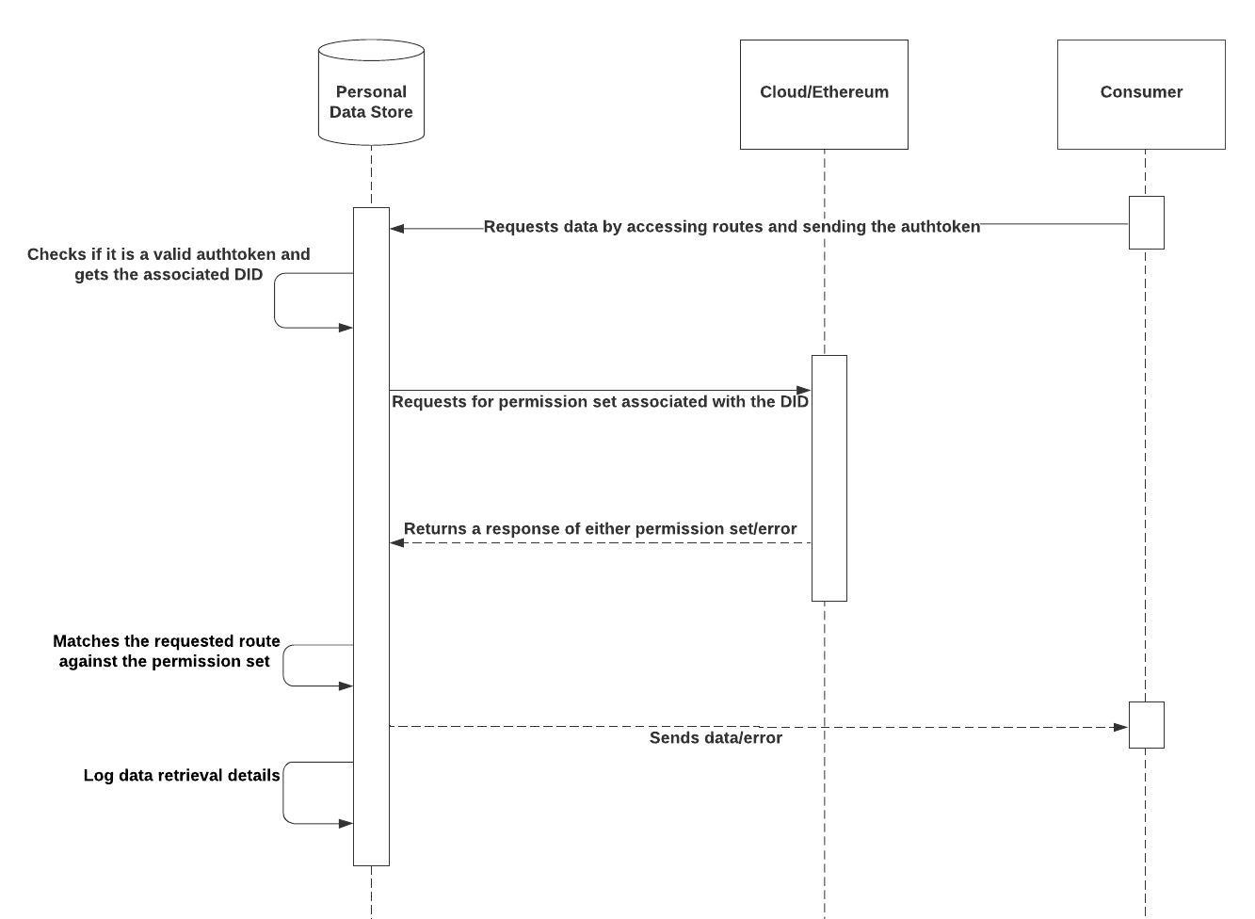

Slide 30
